Slide 1
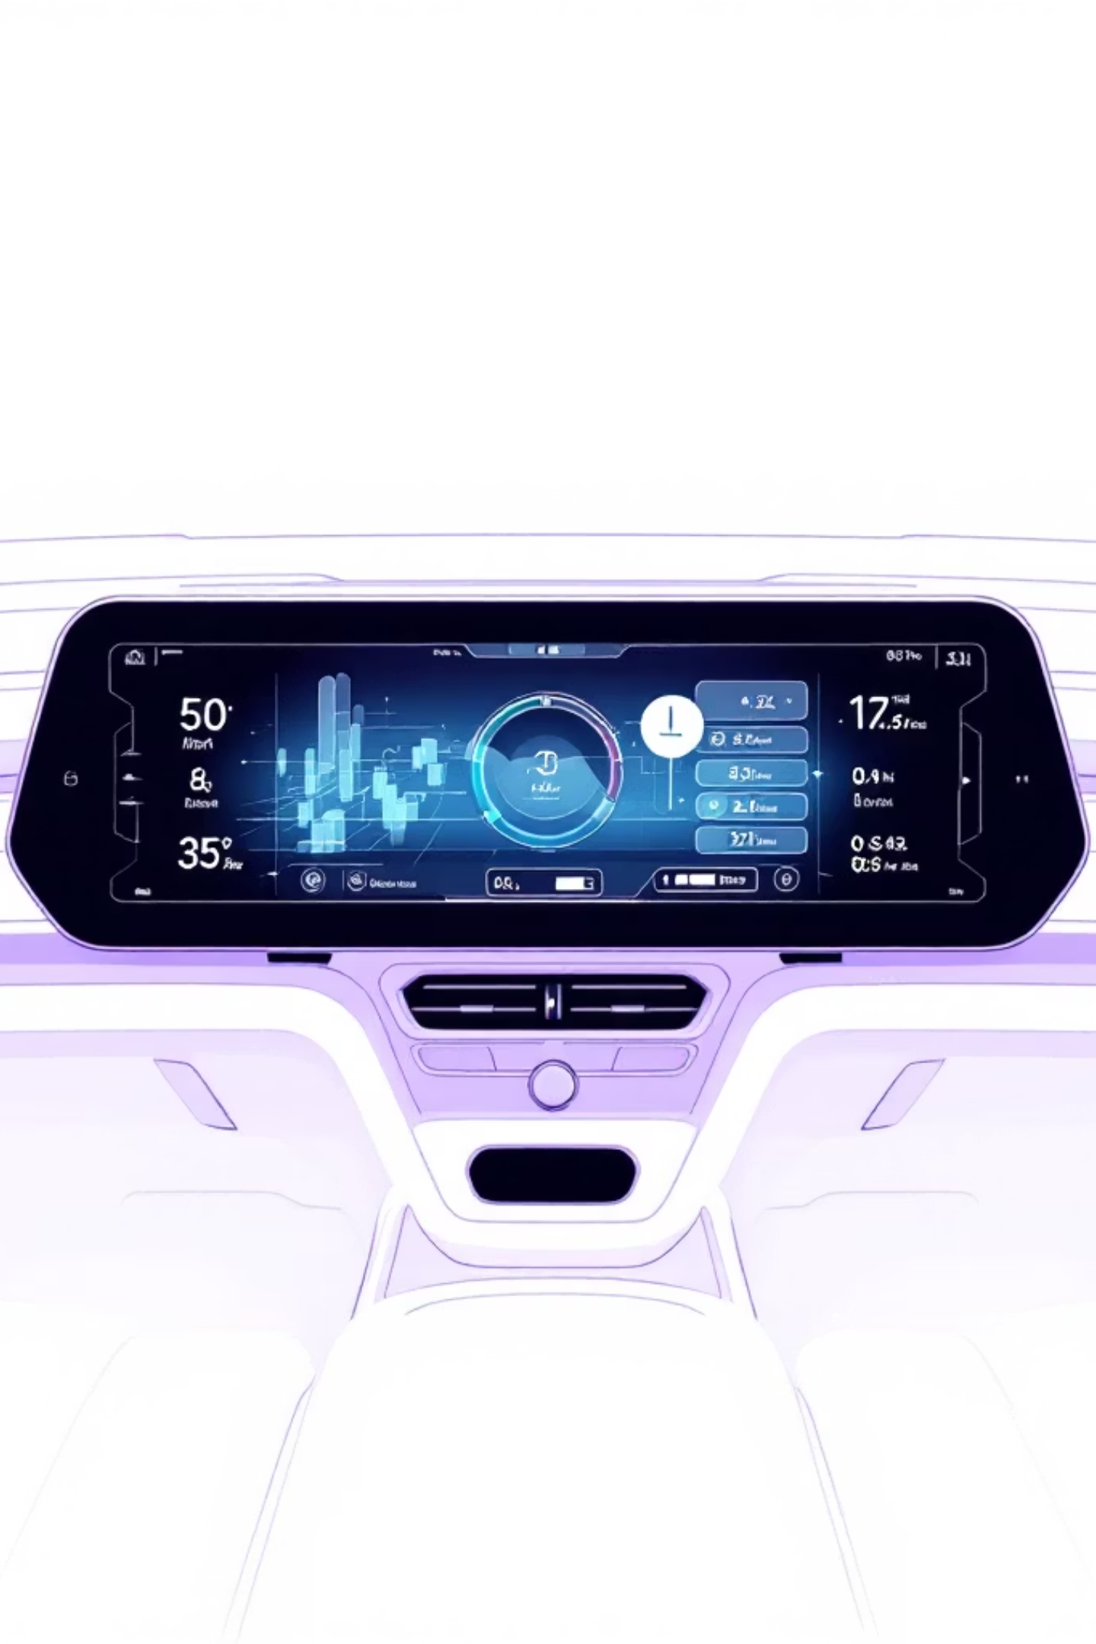
Driver Drowsiness Detection System
Real-time facial recognition for enhanced road safety
Sneha Narsale, Tejaswini Mane, Sanjana Manjulkar, Payal Khandagale, Savita Biradar
Department of Computer Engineering, Zeal Polytechnic, Pune, India

Slide 2
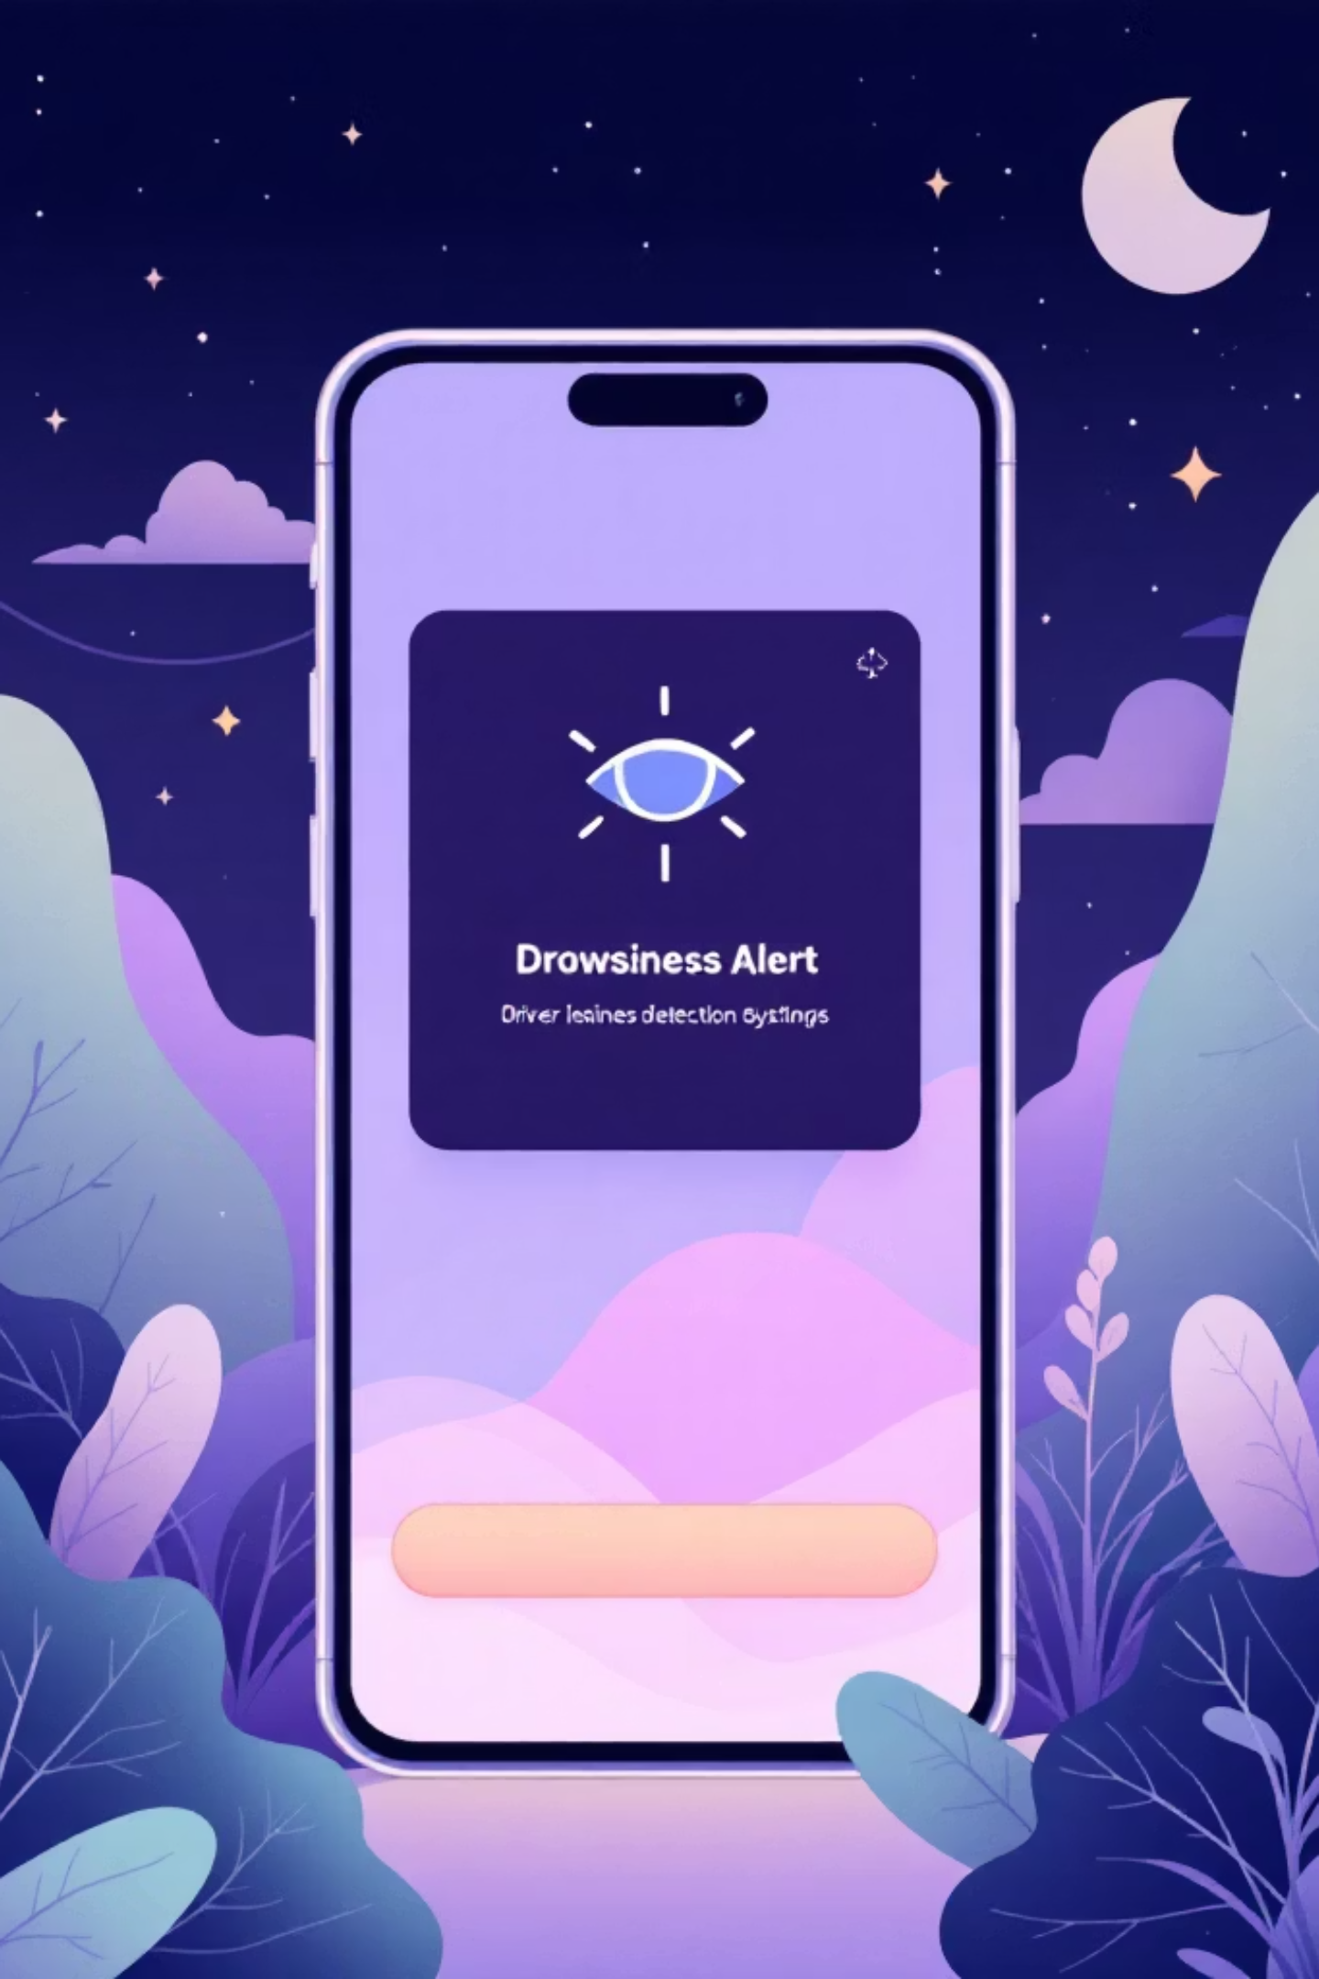




Abstract
Real-Time Monitoring
Adaptive Alerts
Facial recognition tracks eye movements, blink frequency, head orientation
Timely warnings and break recommendations based on fatigue indicators
Safety Enhancement
Reduces accident risk through proactive, human-centered mechanism

Slide 3

Introduction
Emotion-Aware AI
Impact on Performance
Detects and interprets human emotions through facial expressions, voice patterns, behavioral signals
Emotional states affect concentration, motivation, decision-making, productivity
01
02
Detect Fatigue
Adapt Responses
Real-time facial cues analysis
Adjust alerts and assistance
03
Improve Safety
Reduce stress, enhance well-being

Slide 4

Problem Definition
Traditional Limitations
Vehicle safety systems assume constant vigilance, ignore behavioral factors affecting driving performance
Missing Indicators
Fail to recognize real-time fatigue signs: prolonged eye closure, slow blinking, head nodding
Research Gap
Need reliable, privacy-friendly, vision-based systems with adaptive warnings and break recommendations

Slide 5
Literature Review
Drowsiness Detection
Adaptive Monitoring
Privacy Concerns
Facial cues, eye movements, physiological signals. CNNs and feature embedding improved accuracy in real-time conditions.
Real-time drowsiness indicators adjust alert intensity, suggest breaks, modify assistance levels.
Cloud processing raises privacy issues. Local device-based solutions provide personalized safety without external data transmission.

Slide 6

Comparative Analysis
Traditional Alerts
Cloud-Based Systems
Generic warnings, no fatigue tracking, limited effectiveness
Detailed analysis, adaptive warnings, privacy concerns, requires internet
Local On-Device
Real-time detection, offline functionality, secure data, optimal balance

Slide 7
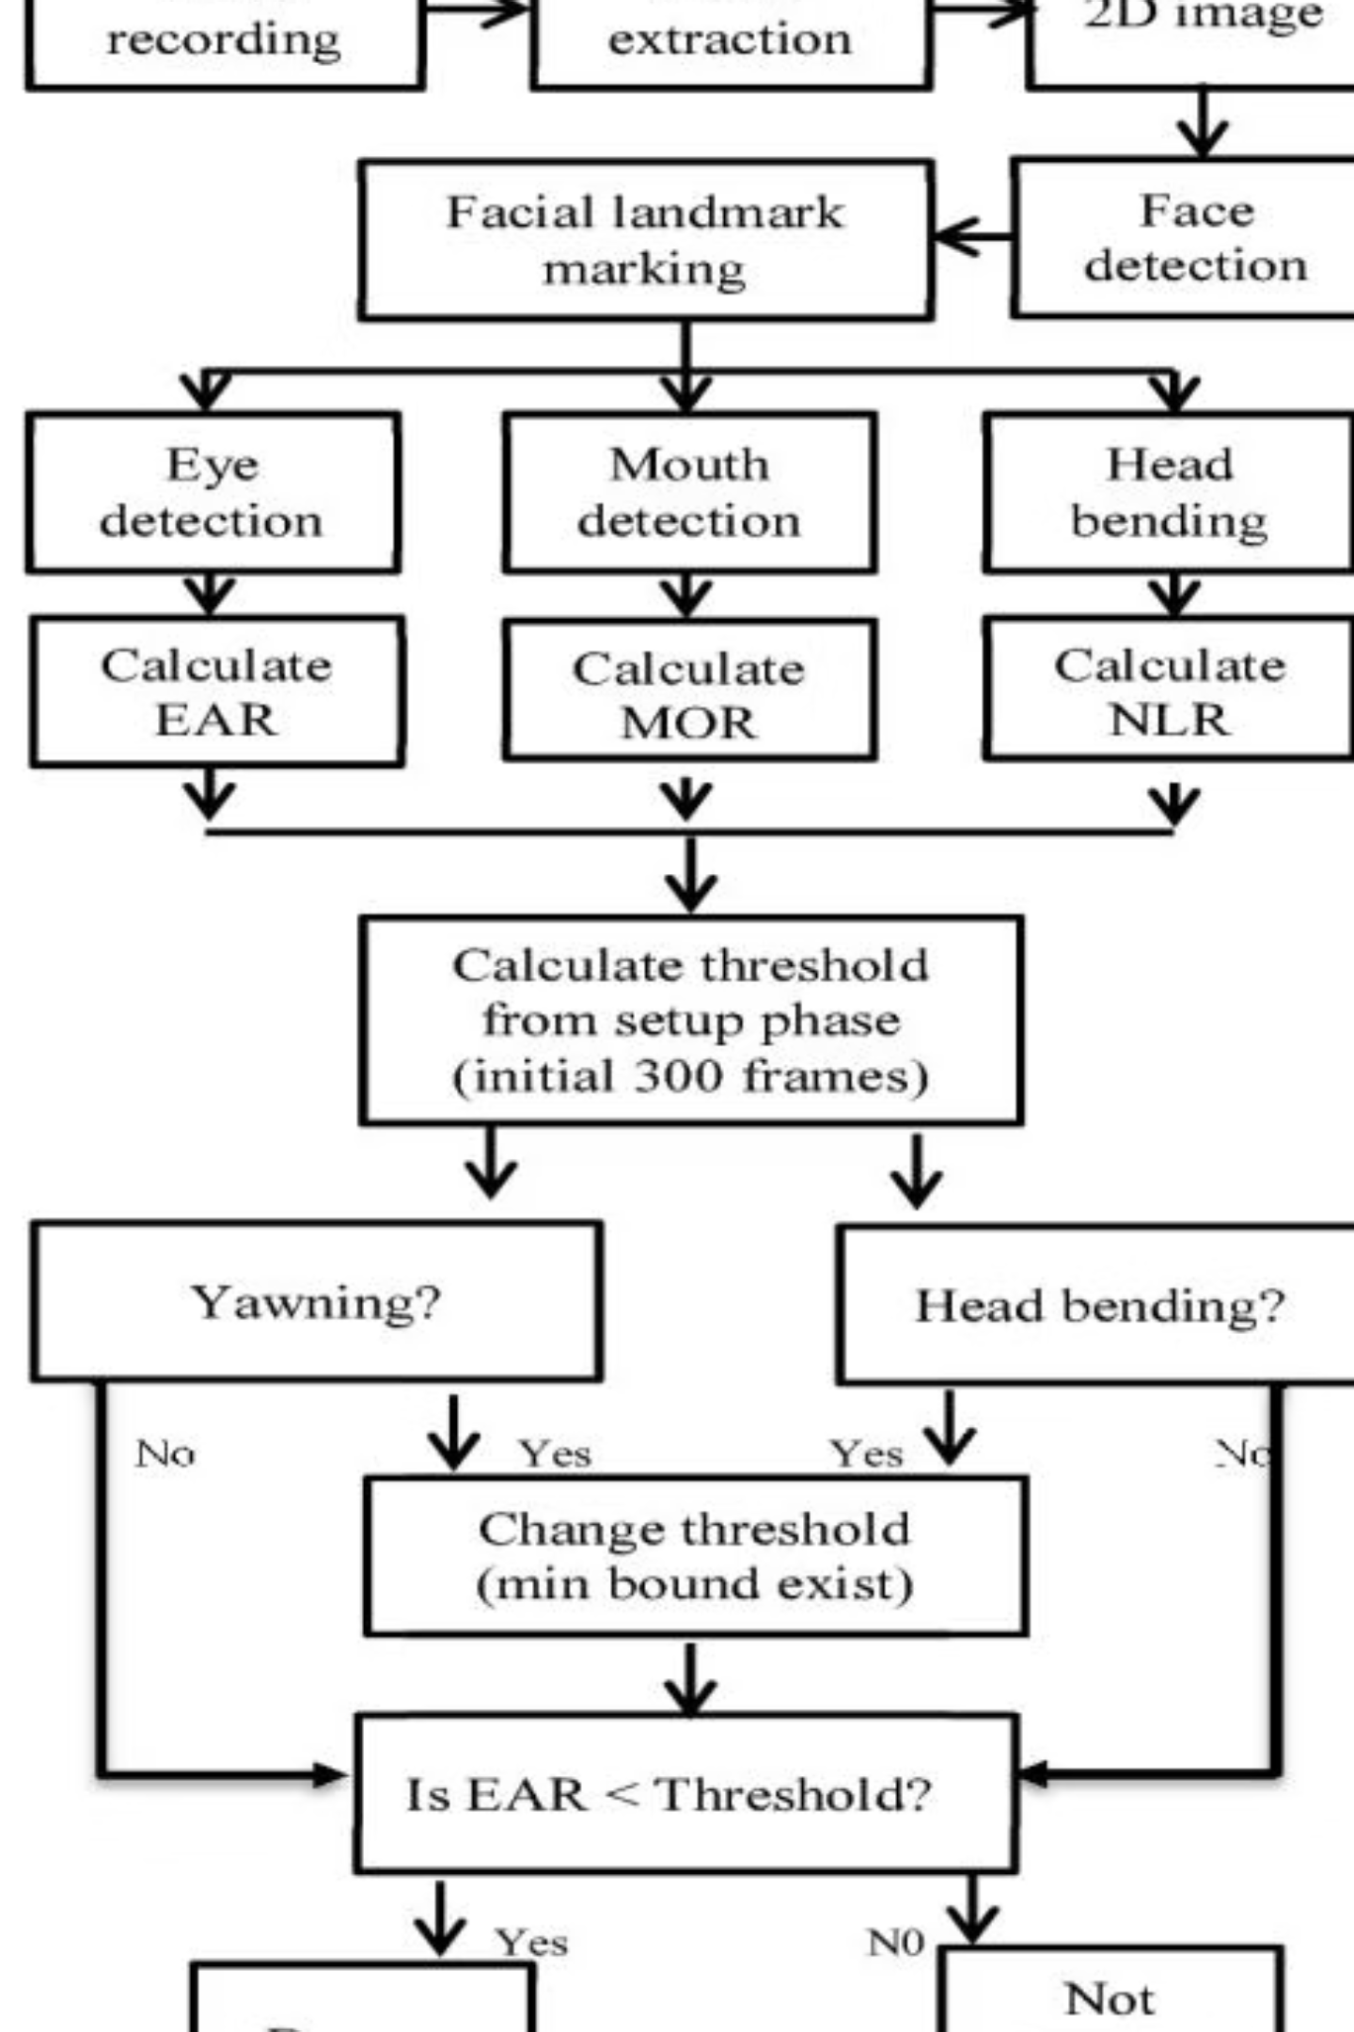




Proposed System Architecture
Video Recording
Frame extraction
Face Detection
Landmark marking
Feature Analysis
EAR, MOR, NLR calculation
Threshold Check
Fatigue determination

Slide 8
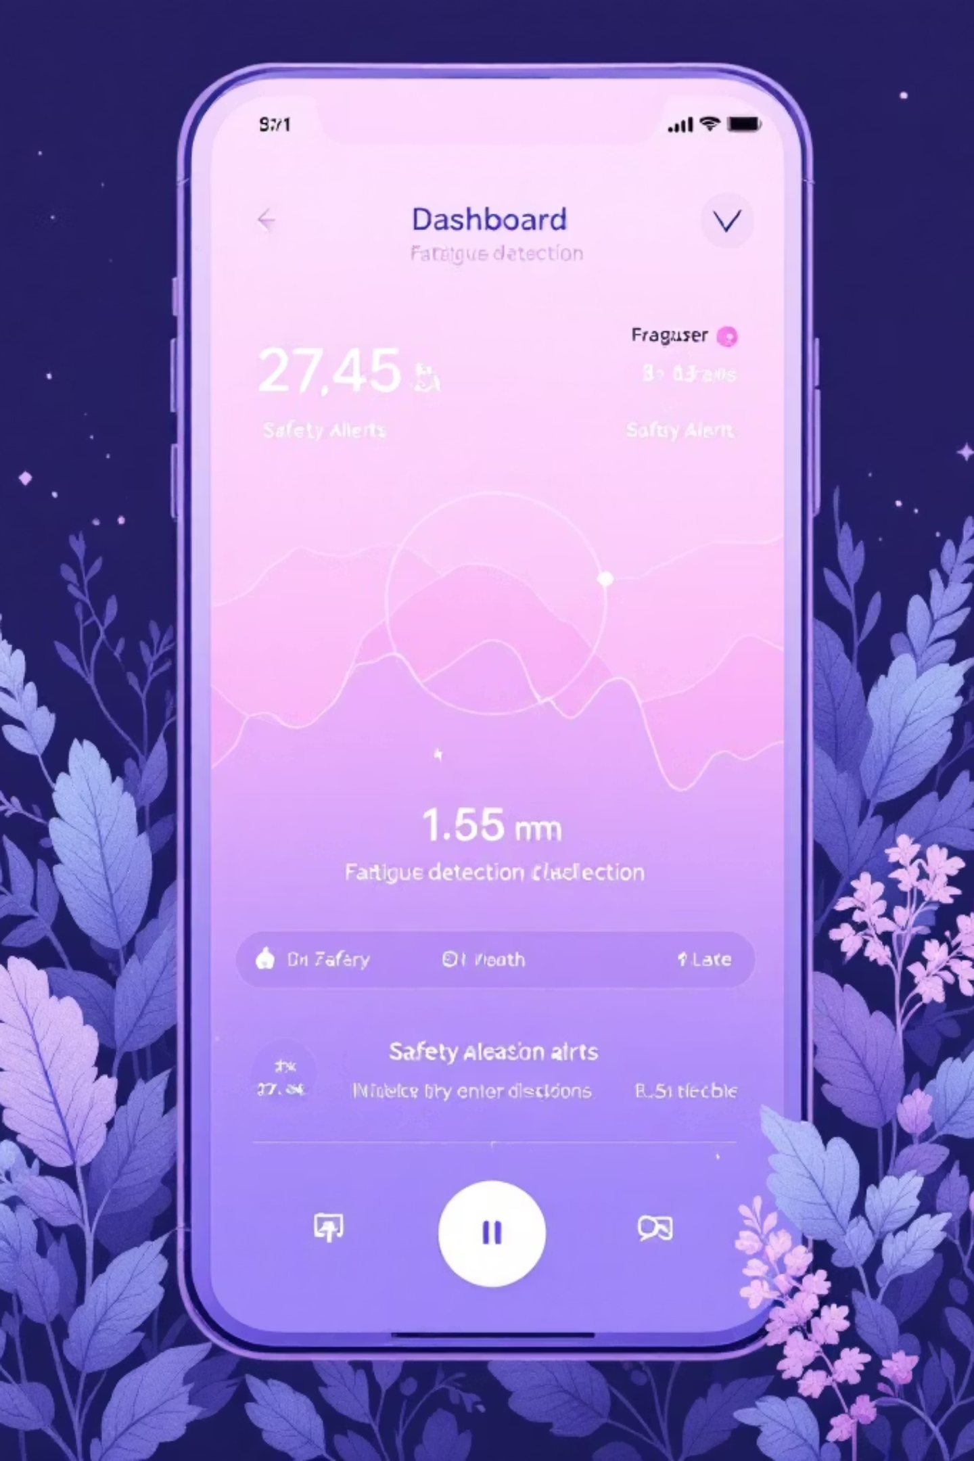
System Components
Android UI Layer
Login, dashboard, real-time alerts, safety notifications
Fatigue Detection
Deep learning models analyze eye closure, head position, yawning
Alert System
Dynamically adjusts intensity, recommends breaks, modifies assistance
Local Storage
Encrypted database, no external transmission, privacy protection

Slide 9




Conclusion
Transformative Approach
Real-Time Detection
Facial cues, eye closure, head movements enable timely alerts
Personalized safety interventions improve reaction time, reduce crash risk
Privacy First
Local on-device processing ensures offline functionality, secure data management

Slide 10
References
Picard, R. W. (1997). Affective Computing. MIT Press.
Calvo, R. A., & D'Mello, S. (2010). IEEE Transactions on Affective Computing, 1(1), 18-37.
Chen, L., Chen, P., & Lin, Z. (2018). Computers in Human Behavior, 87, 92-101.
Hernández, J., & Picard, R. W. (2013). International Conference on Affective Computing.
Ko, B., & Kim, J. (2020). Expert Systems with Applications, 142, 112976.
Ji, Q., Zhu, Z., & Lan, P. (2004). IEEE Transactions on Vehicular Technology, 53(4), 1052-1068.
Zhang, X., Wang, Y., & Wang, J. (2018). IEEE Access, 6, 43233-43244.
Abtahi, F., et al. (2014). Computers & Electrical Engineering, 40(1), 59-74.
Lin, C., Liu, C., & Lai, C. (2019). International Journal of Automotive Technology, 20(5), 987-998.

